Slide 1


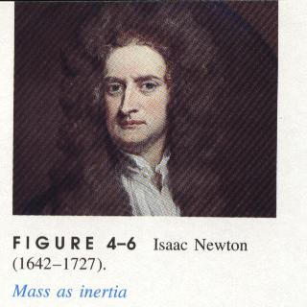

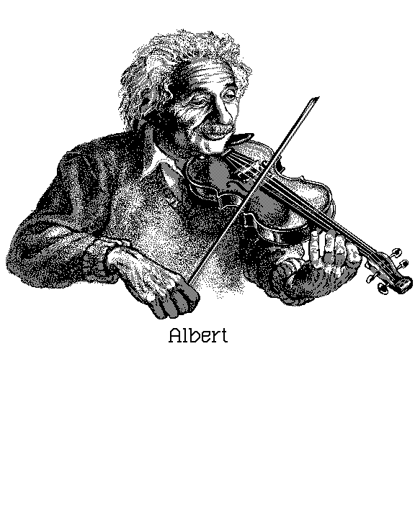
UNIVERSITY PHYSICS 3

Slide 2


Part Four Oscillation and Waves
第 四 篇 振动和波动

Slide 3
Chapter 9 Mechanical Oscillation
第9章 机械振动
Chapter 10 Mechanical Wave
第10章 机械波

Slide 4

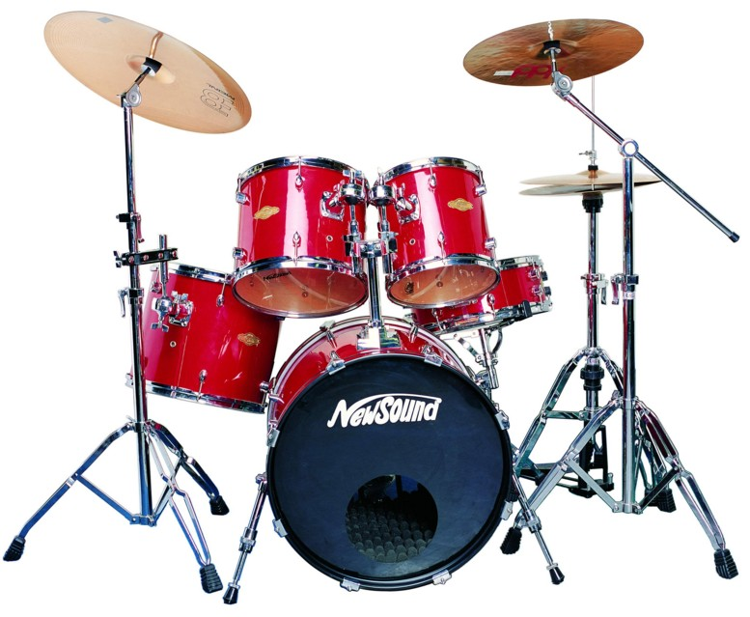
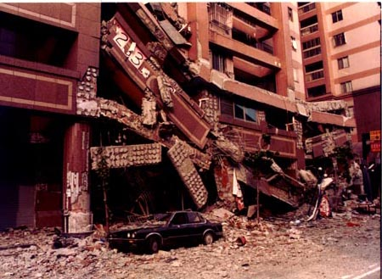
Chapter 9 Simple Harmonic Motion
第9章 简谐振动

Slide 5
§9-1 Simple Harmonic Motion (SHM)
简谐振动
§9-2 Amplitude Period Frequency & Phase
简谐振动的振幅, 周期，頻率和位相
§9-3 The Energy of SHM
简谐振动的能量
§9-4 Damped Vibration& Forced Vibration Resonance 阻尼振动 受迫振动 共振
§9-5 Superposition of two SHM with same
Frequency in same Direction
同方向同頻率的简谐振动的合成
§9-6 Superposition of two Perpendicular SHM
相互垂直的简谐振动的合成

Slide 6

教学要求
1、确切理解描述谐振动的特征量的物理意义，并能熟练 地确定振动系统的特征量，从而建立谐振动方程；
2、掌握描述谐振动的旋转矢量法和图线表示法；
3、掌握谐振动的特征和规律；
4、了解阻尼振动、强迫振动和共振的发生条件和规律；
5、掌握同方向、同频率谐振动的合成的特点和规律，了 解互相垂直谐振动的合成的特点.

Slide 7
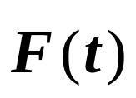

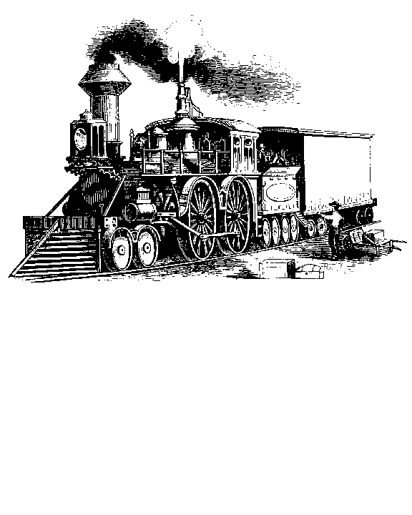
Introduction
An infinite number of ways in which a force may vary.
Varying force:
particularly
Periodic motion
Vibration: a restoring force

Slide 8

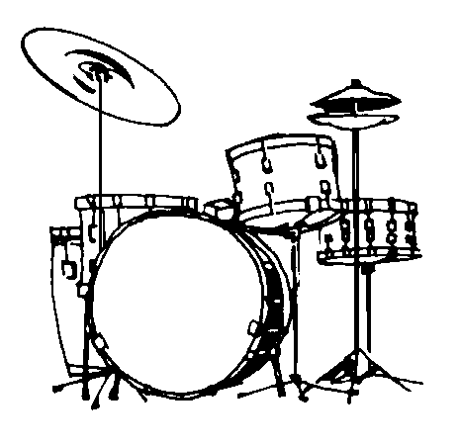



振动
共振现象
四季的变化

Slide 9
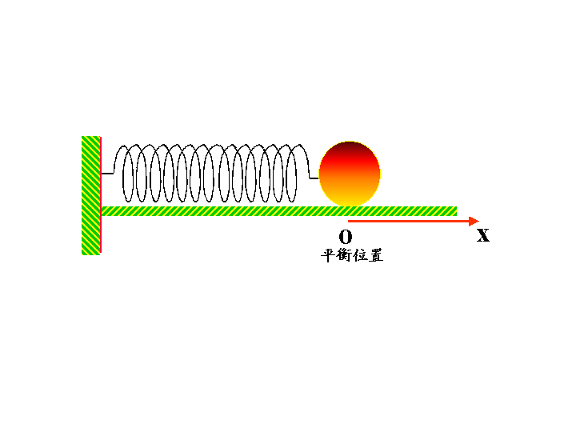
In this chapter, we will study the most important periodic motion-------Simple Harmonic Motion(简谐振动), which is base to investigate(研究） the complex periodic motion.
复杂运动
周期运动
简谐振动
波动、电磁波、电压电流等等

Slide 10



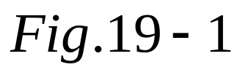
§9-1 Simple Harmonic Motion 简谐振动
1. The simple harmonic motion（abbreviate:SHM）
The system ( block-spring) in Fig.19-1 is called as a simple harmonic oscillator(谐振子）：
Spring: 不计质量。
body:
Equilibrium position: point o(和外力等于零）;
物体：在平衡位置附近作周期性往复运动；
坐标原点：通常取为平衡位置o；

Slide 11

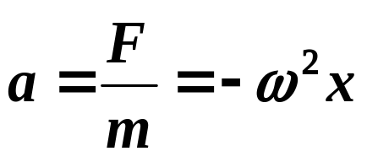
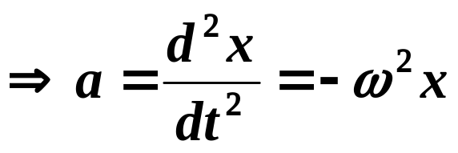
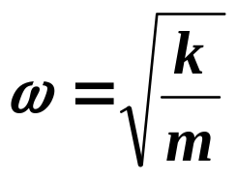
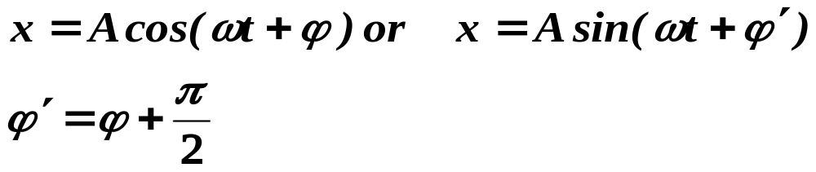
Spring: deformation x;
Body:
displacement x;
force: (frictionless);
acceleration:
which solution is
This equation is called the harmonic equation.

Slide 12


Summary:
If the body is subject to:
A restoring force that is proportional to the displacement but opposite in sign( ) ;
or
The acceleration is proportional to its displacement and of opposite sign( ) ;
or
The motion equation is ;

Slide 13
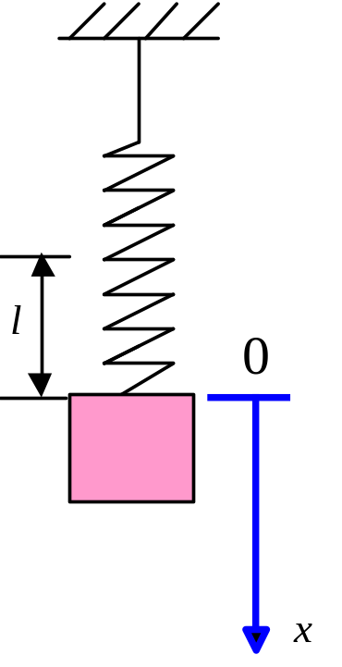

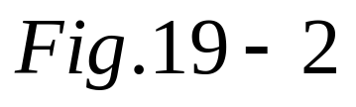
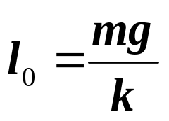
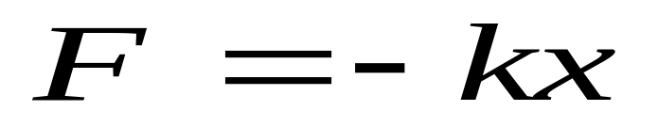
Example 9-1:prove the system is a simple harmonic oscillator as shown in Fig.19-2.

Slide 14
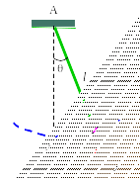




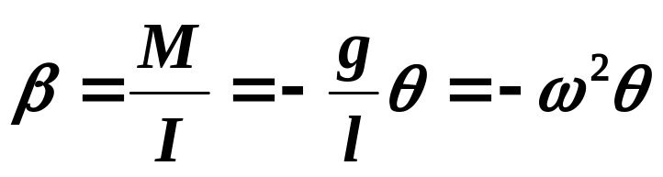
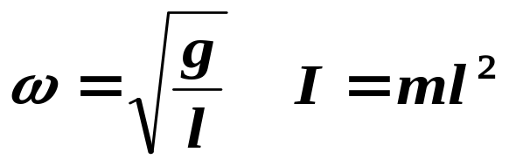

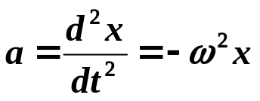
Example 9-2: In Fig.19-3, prove the simple pendulum(单摆） is a simple harmonic oscillator when θ is small.
Prove:
(1) Displacement:
(2)Restoring torque(恢复力矩）:
(3) Angular（角量） acceleration:
Note:
(linear线量)

Slide 15
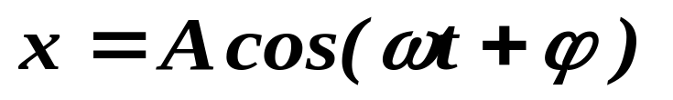
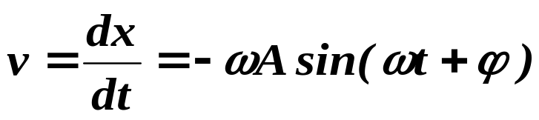
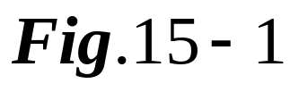
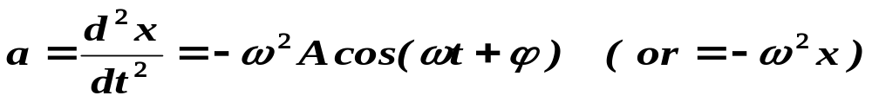
2. The velocity and acceleration of SHM:
Its velocity is given by:
and its acceleration is equal to:

Slide 16
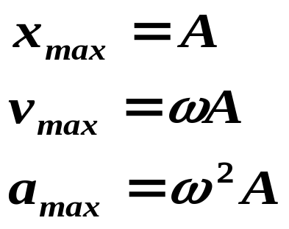

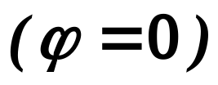

Note:
(1) Maximal values:
(2) The curves of :
x、 υ 、a
ω ²A
a
ω A
υ
A
x
T
o
t
-A
-ω A
-ω ²A
υ > 0
< 0
< 0
> 0
a < 0
< 0
> 0
> 0
减速
加速
减速
加速
(3)看图： .

Slide 17
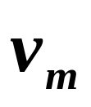

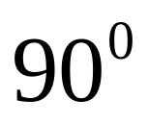
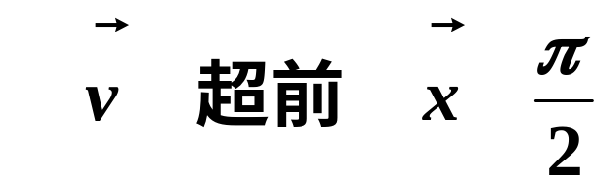
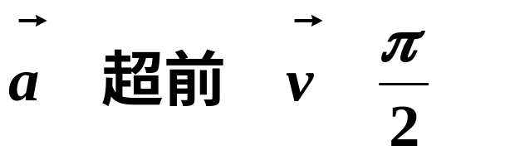
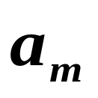
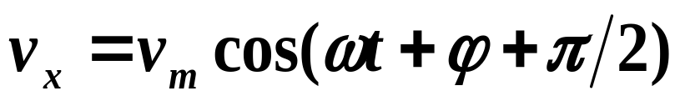
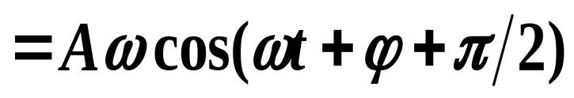
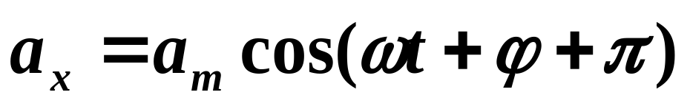
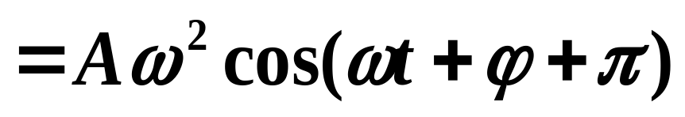
由图可见：
ω
ω
ω t+ϕ
·
o
x
ω

Slide 18






3. The rotating vector representation(旋转矢量表示法） of SHM
A vector with a length A is rotating about point o at an angular velocity ω in Fig.19-4.

Slide 19

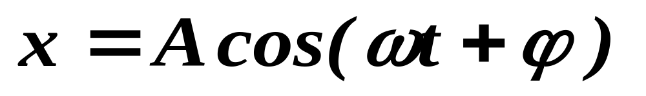

The projection P of this rotating vector in x-axis is given by
which is as same as the equation of SHM.
one to one
A rotating vector
SHM
一一对应

Slide 20

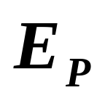

4. Remarks:
A simple harmonic oscillator has to have two parts:
(1)‘Spring’ which provides a restoring force( that is it store the potential energy);
(2) ‘Body’ which has inertia( that is it store the kinetic energy).

Slide 21
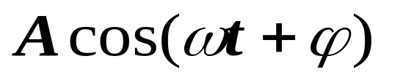
§9-2 Amplitude (振幅) Period (周期) Frequency (頻率) and Phase (位相) of SHM
1.Introduction
From
We can see that:
(1) The displacement is determined by three quantities: A, ω, ϕ ;
(2) is a periodic function of time t.

Slide 22


2. 描述简谐振动的特征量
振幅A：简谐振动的物体离开平衡位置的最大位移的绝对值（由初始条件决定）(代表系统总能量的多少）。

Slide 23
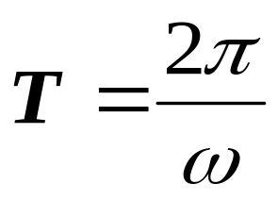
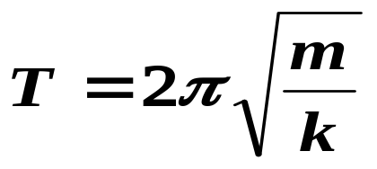
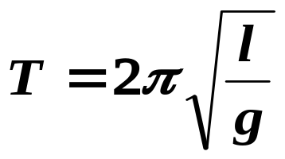
周期T：完成一次全振动所需时间
For block-spring system:
and for simple pendulum system:
由系统的力学参数决定 — 固有周期

Slide 24

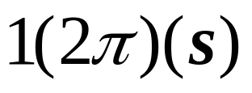
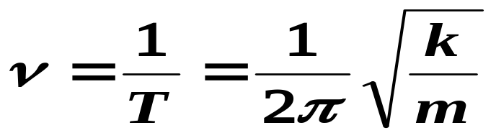

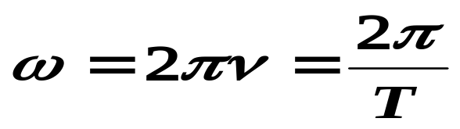
频率 :单位时间完成全振动的次数
固有频率
角频率 :2π秒内完成全振动的次数

Slide 25


相位 ：决定任意时刻 t 运动状态的物理量
初相 ：决定初始时刻 t=0 运动状态的物理量

Slide 26


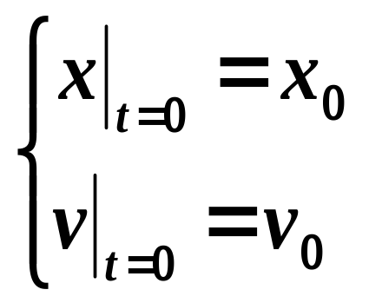
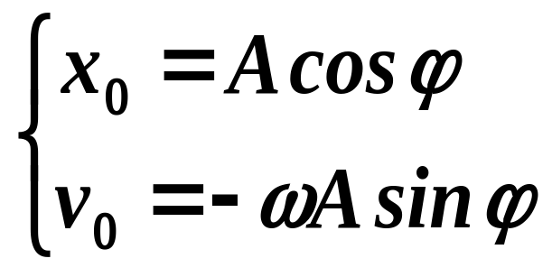
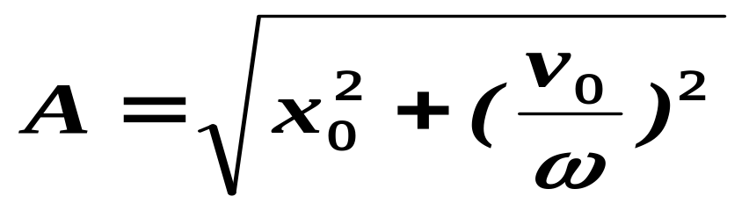
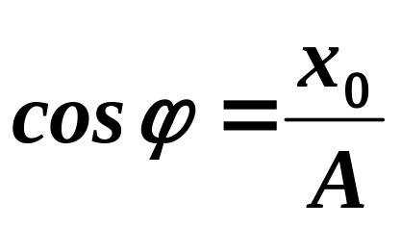
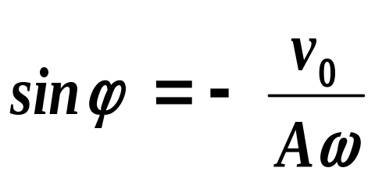
2. 振幅和初相的确定
Initial conditions:
初始时刻的位置和速度
可解出：
or

Slide 27


关键问题：决定ϕ
（1）由 决定 的两个可能值： ；
（2）由 的正负选出正确的 。
关键：正确判断初始时刻的位置和速度的正负！！

Slide 28





Example 9-3:一个质量为10g的物体作简谐振动，周期为4s,t=0时坐标为24cm速度为零。计算：（1）t=0.5s时物体的位置；(2) t=0.5s时物体受到的力的大小和方向；(3)从初始位置运动到x=-12cm所需的最少时间；(4)x=12cm时物体速度的大小。
解：本题已知物体作简谐振动。周期为4s,振幅为24cm,则：
由初始条件：

Slide 29






（1）当t=0.5s时：
（2）当t=0.5s时，物体受力：
与x轴正向相反。
（3）从初始位置运动到x=-12cm的最少时间：
-12cm
24cm

Slide 30




（4）x=-12cm物体的速度大小：
注意：单位换算。

Slide 31









Example 9-4:如图19-5，为质点作谐振动的x随时间的变化曲线。求质点的振动方程和初速度。
X(cm)
解：（1）由x-t曲线知：
4
2
2
5
o
t(s)
（2）设质点的振动方程为
t=0时：

Slide 32


所以：
(IS)
（2）当t=0时，速度等于：
注意：（1）看图识‘量’；
（2）正确写出初始条件；
（3）ϕ的选择。

Slide 33





Example 9-5:给出下列系统的等效弹性系数。

Slide 34








Example 9-6: 在一轻弹簧下端悬挂m₀=100g砝码时，弹簧伸长8cm,现在这弹簧下悬挂m=250g的物体，将物体从平衡位置向下拉动4cm，并给予向上的21cm/s的初速度（此时t=0).选x轴向下，如图19-6，求振动方程的数值表达式。
解：（1）由题可得
（2）园频率：

Slide 35




（3）设运动方程为：
初始条件：
可给出：
则：
（IS）

Slide 36







Example 9-7: 一轻弹簧在60N的拉力下伸长30cm,现在这弹簧下悬挂m=4kg的物体，使其静止,再将物体从平衡位置向下拉动10cm由静止释放（此时t=0). 如图19-7，求:(1)振动方程的数值表达式;(2)物体在平衡位置上方5cm时弹簧对物体的拉力;(3)物体从第一次越过平衡位置时刻起到它运动到上方5cm处所需要的最短时间。
解：（1）由题可得:
(2)选x轴向下为正:

Slide 37












(3)设物体在平衡位置上方5cm时弹簧对物体的拉力f:
负号‘-’表方向向上,为拉力.
(4)分两步:第一次到达平衡位置的时间t₁
第一次到达平衡位置上方5cm的的时间t₂

Slide 38




§9-3 The Energy of SHM 简谐振动的能量
The potential energy of the system is:
and its kinetic energy is equal to
It can be proved that its total energy is constant:
You might now understand why an oscillating(振动) system normally contains an element of springiness and an element inertia.

Slide 39








Conclusions:
①谐振动的总能量与振幅的平方成正比；
②如图9-8,谐振动的动能和势能相互转化，总能量守恒.
③ 关系:

Slide 40



Example 9-8:x为何值时谐振子系统的动能等于势能?
解: 设x=x_{P}处
则:

Slide 41



Example 9-9:如果谐振子的振动频率为ν.问其动能和势能的变化频率为多少?
解: 因为
而
所以动能和势能的变化频率为:2ν.

Slide 42
§9-5 Damped Vibration Forced Vibration and Resonance(阻尼振动 受迫振动 共振)
1. Damped Vibration 阻尼振动
Drag force
The motion dies out eventually!!
In the air

Slide 43
Drag force
In the water
When the motion of an oscillator is reduced by an external force, the oscillator and its motion are said to be damped.

Slide 44



In the following, take the harmonic oscillator as an example and consider only the frictions of surrounding media. For the case of low speed, the friction of media can be expressed as
In the water
which has three solutions: underdamped vibration, overdamped vibration and critical damping.

Slide 45



Underdamped vibration（欠阻尼）:
特征:
γ小, 振动很多次;
振幅逐渐减小;
不是周期运动, 但可引入周期.
——阻尼系数,由阻力系数决定。

Slide 46

Overdamped vibration（过阻尼） and critical damping:
特征:
Critical damping:能回到平衡位置;
Overdamped vibration:不能回到平衡位置(需无限长时间);
In the oil

Slide 47
2. Forced Vibration and Resonance(受迫振动 共振)
Drag force
The motion dies out eventually!!
In the air
Provide energy
(force it vibrate)
Add an additional force called as a driving force to a harmonic oscillator. This motion is a forced vibration.

Slide 48


Example: a girl(child) sitting on a swing(秋千).
OK!
gently
By giving the girl a little push once each cycle, you can maintain a nearly constant amplitude.

Slide 49






In general, a driving force is chosen as
In the following, the natural ( or intrinsic 固有的) angular frequency of the system is denoted by ω₀ such as . Therefore, we have
Its solution consists of two parts:

Slide 50


特征:
频率与驱动力的频率相同;
振幅A与ω、 ω ₀、γ 和F₀有关，特别是ω的函数。
γ→0
Small γ
large γ
o

Slide 51

Resonance(共振):
From the following figure, the amplitude is greatest when
depending on γ.
A condition called Resonance.
o

Slide 52


Applications:
(1)All mechanical structures have one or more natural angular frequencies;
(2) strengthen vibration(增强):
(3) reduced vibration(减弱):
Aircraft designer
Earthquake

Slide 53


§9-4 The composition of two harmonic vibrations with the same direction and same frequency 两个同方向同频率简谐振动的合成
1.Introduction
A particle may takes part in two harmonic oscillations ;
For the next chapter and many fields;

Slide 54



2.The composition of two harmonic vibrations with the same direction and same frequency
The displacements resulting from two harmonic vibrations in the same straight line (x-axis) are
It can be proved that the displacement of composition vibration is given by
with the same angular frequency ω.

Slide 55










It is easy to prove using the rotating vectors:

Slide 56


depend on A₁,A₂ and ϕ₁- ϕ₂.
There are two special situations:
(1) when
Enhancing(加强）

Slide 57


(2) when
Weakening (减弱）
In general

Slide 58





Example 9-9:The two harmonic vibrations are
Find their composition vibration.
Solution:
Hence:

